Slide 1
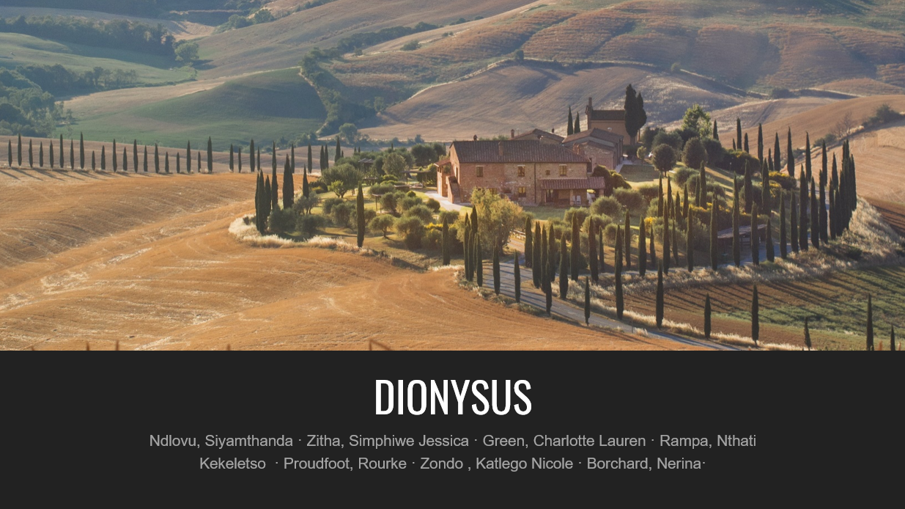
DIONYSUS
Ndlovu, Siyamthanda · Zitha, Simphiwe Jessica · Green, Charlotte Lauren · Rampa, Nthati Kekeletso · Proudfoot, Rourke · Zondo , Katlego Nicole · Borchard, Nerina·

Slide 2

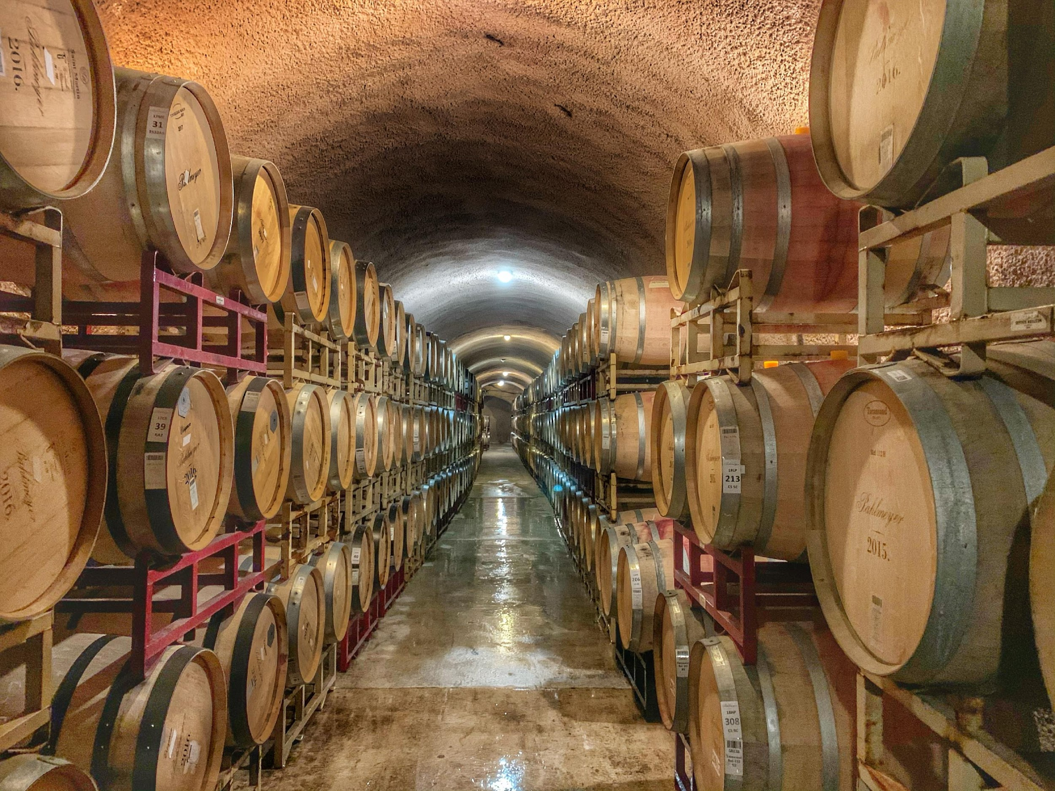
DIONYSUS
DIONYSUS
Named after the Greek God of Wine, Insanity and certainly more...Dionysus acting as a way to connect you to your desired experience.
Let the insanity begin.

Slide 3
Overview
Dionysus has set out to allow wineries and possible customers to have easy and user friendly access to the beauty that is Winery Tourism.
The group has went forward with the purpose and aim of bridging the gap between technology and wine, making the old, new and refreshing.
A field that has contributed much to our country, South Africa, deserves its own recognition.

Slide 4
Task 1 : Research

Slide 5
GENERAL OVERVIEW AND EXPLANATION
Wine Tourism is the act of exploring wine.
South Africa is confirmed to have over 2690 wineries.
South Africa ranks 8th in the world for wine-production.
Wine Tourism has a lot to offer for different people who may require different experiences to ensure they uniqueness shines.

Slide 6
WINE TYPES OR CATEGORIES EXPLAINED
There are 6 main categories of wine all with their own extensions.
Reds are characterised by their dark flavours and tannins.
Whites are characterised by their light flavours.
Rosé has two distinct characteristic groups, namely dry and sweet.
Sparkling wines are carbonated.
Dessert wines are very sweet.
Fortified wines have added spirits.

Slide 7
WINE POINTS AND PRICES
Wines are scored on a scale, up to 100.
Wine prices on average are priced from range R50-R120 per bottle, but that does not mean that the prices are allows in this range and at times can cost more.
Pricing is influenced by many factors.
Factors such as quality, reputation, market and much more play a role.
Wines can fall into 4 ranks:
Entry-level
Mid-range
Premium
Iconic

Slide 8
OTHER USEFUL INFORMATION FOR A WINE TOURIST
Wine tourists can enjoy various experiences such as wine tasting, wine tours, immersive wine making, grape or wine festivals and much more.
Often history tends to play a role in the details of wine.
Wine in South Africa is popular in Cape Town.
Notable farms include:
Groot Constantia
Stellenbosch Vineyards
Franschhoek Wine Valley
Meerlust Estate
…

Slide 9
TASK 2 : (E)ER DIAGRAM

Slide 10
EXPERIENCE
One thing we can say with certainty is that trial and error was the experience.
Information kept being added and removed.
The structure changed on occasion.
Though through discussions and attempts we were able to come up with a diagram that fits our group.

Slide 11
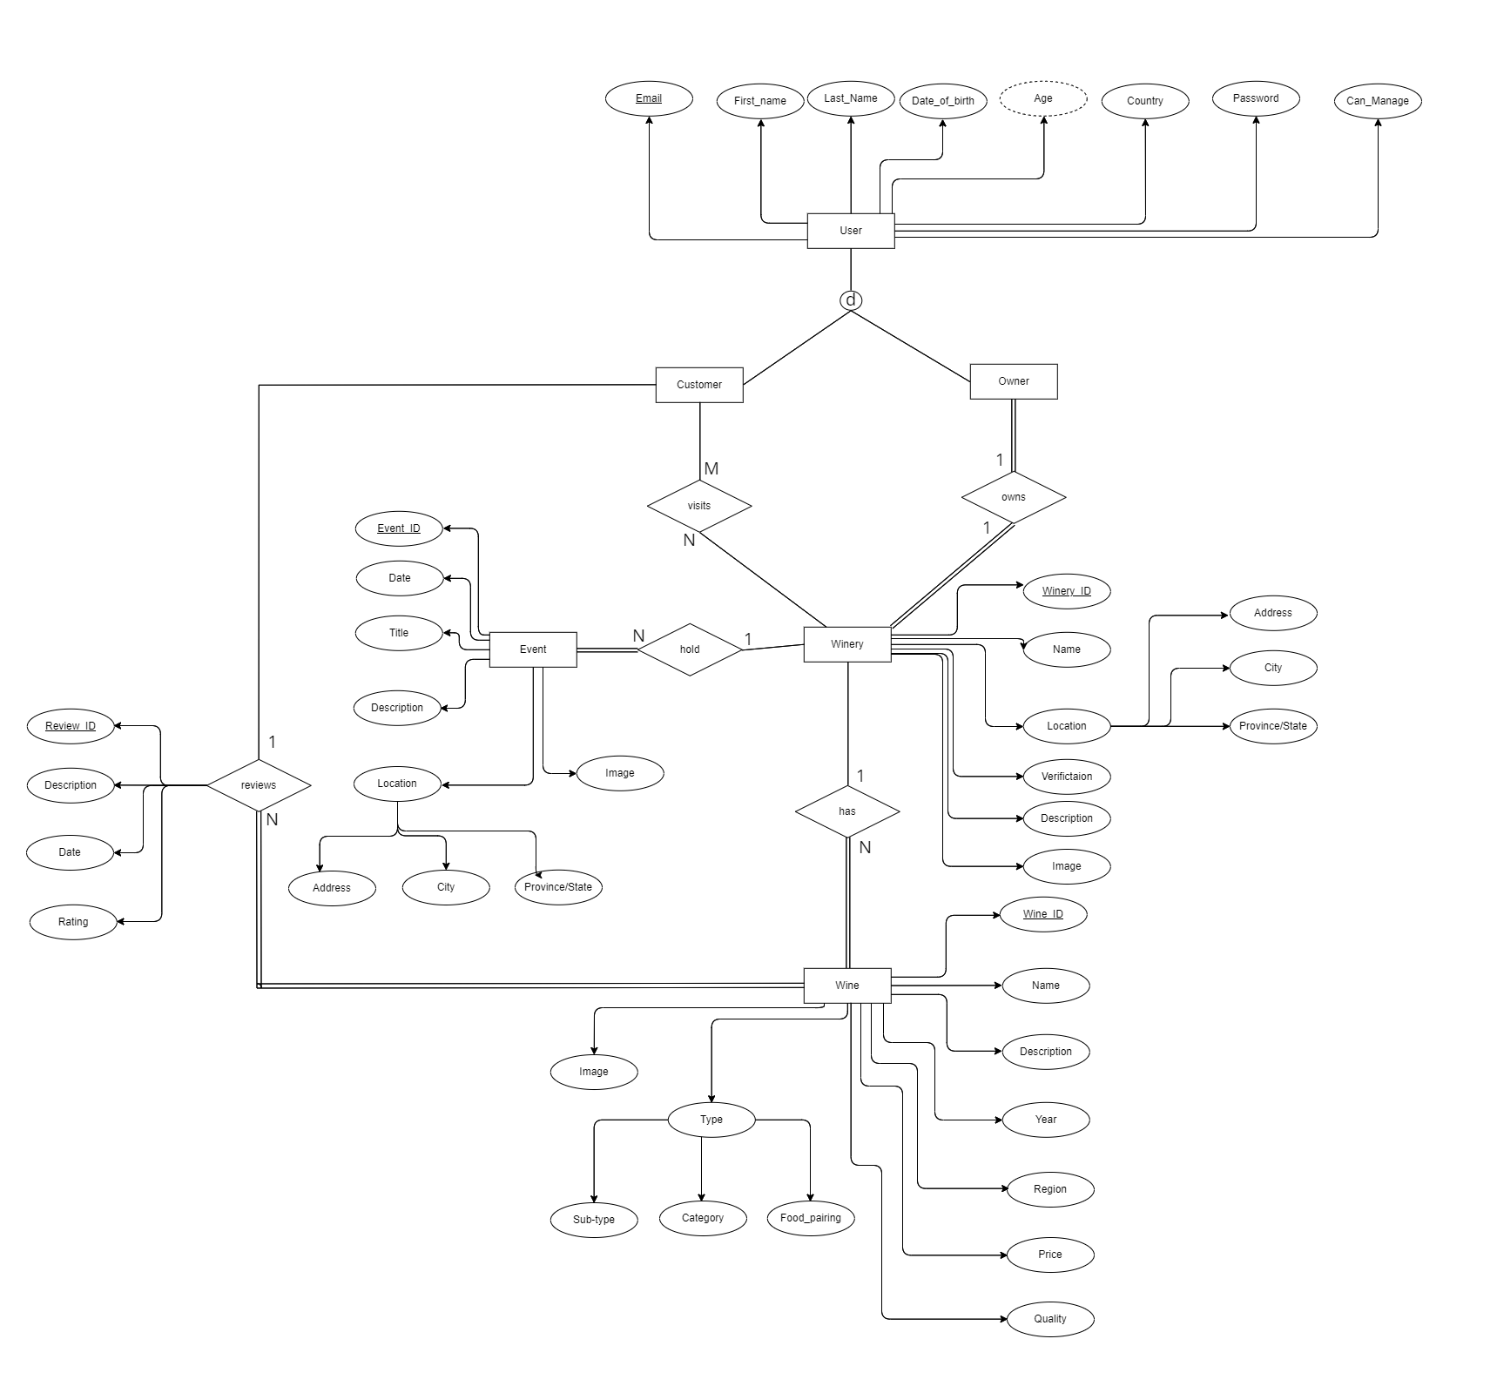
(E)ER-DIAGRAM

Slide 12
Task 3 : (E)ER-DIAGRAM TO RELATIONAL MAPPING

Slide 13
EXPERIENCE
Due to our forever changing (E)ER - diagram, this task had its own challenges.
We followed the necessary steps and achieved completing our Relational Mapping.

Slide 14
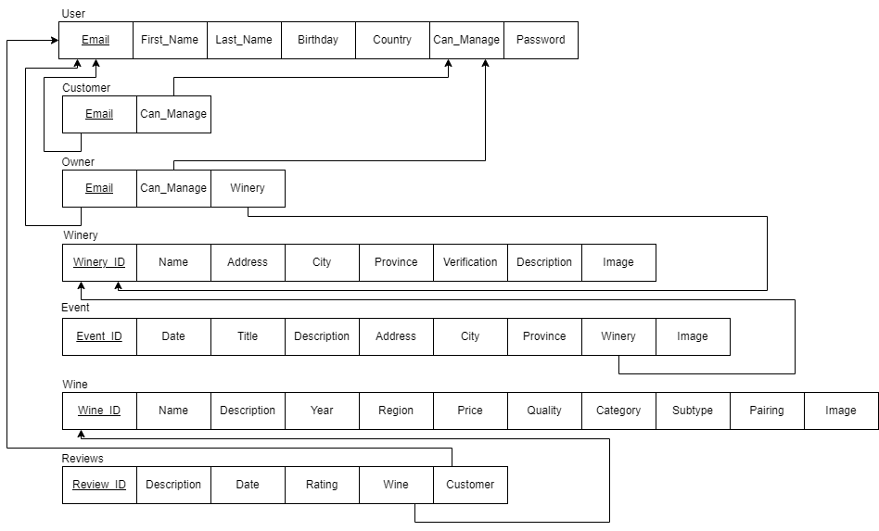
RELATIONAL
MAPPING
Colouring with steps can be viewed in our finalised pdf.

Slide 15
TASK 4: RELATIONAL SCHEMA

Slide 16
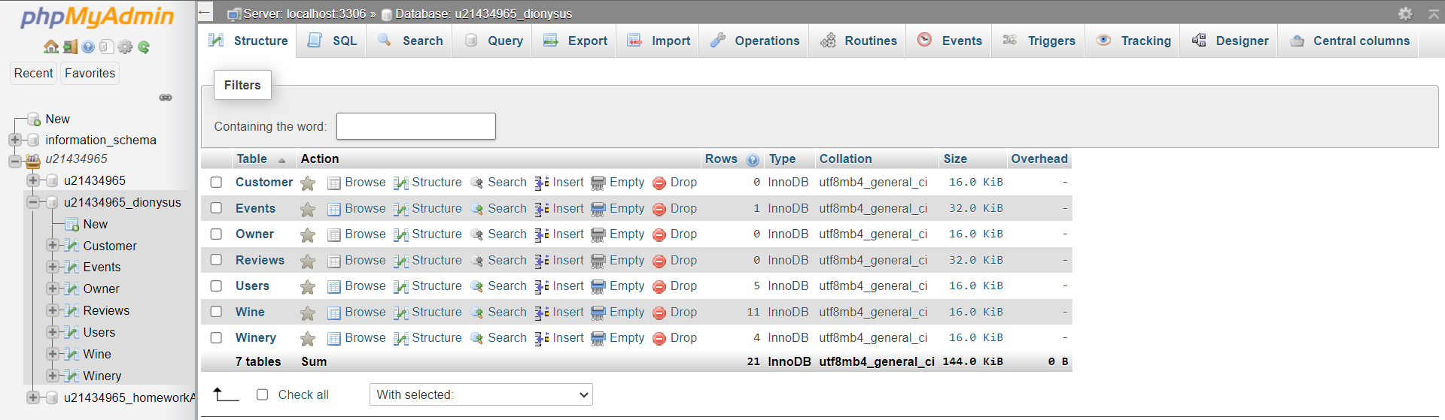
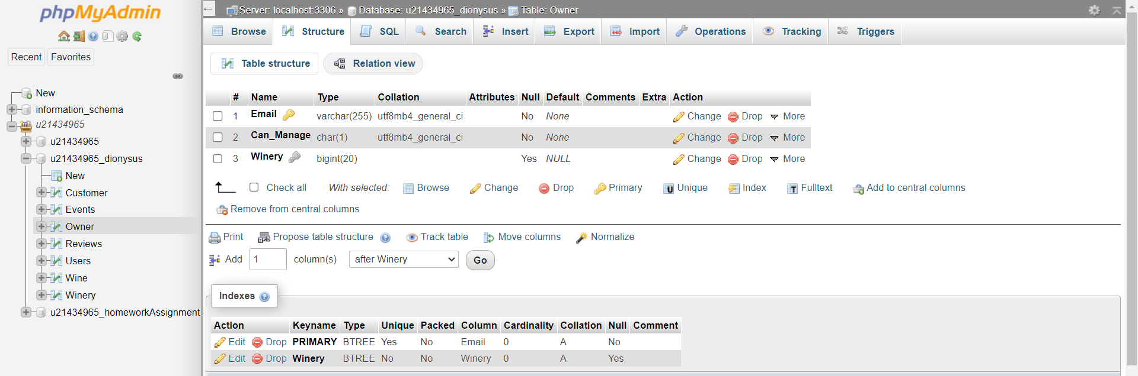
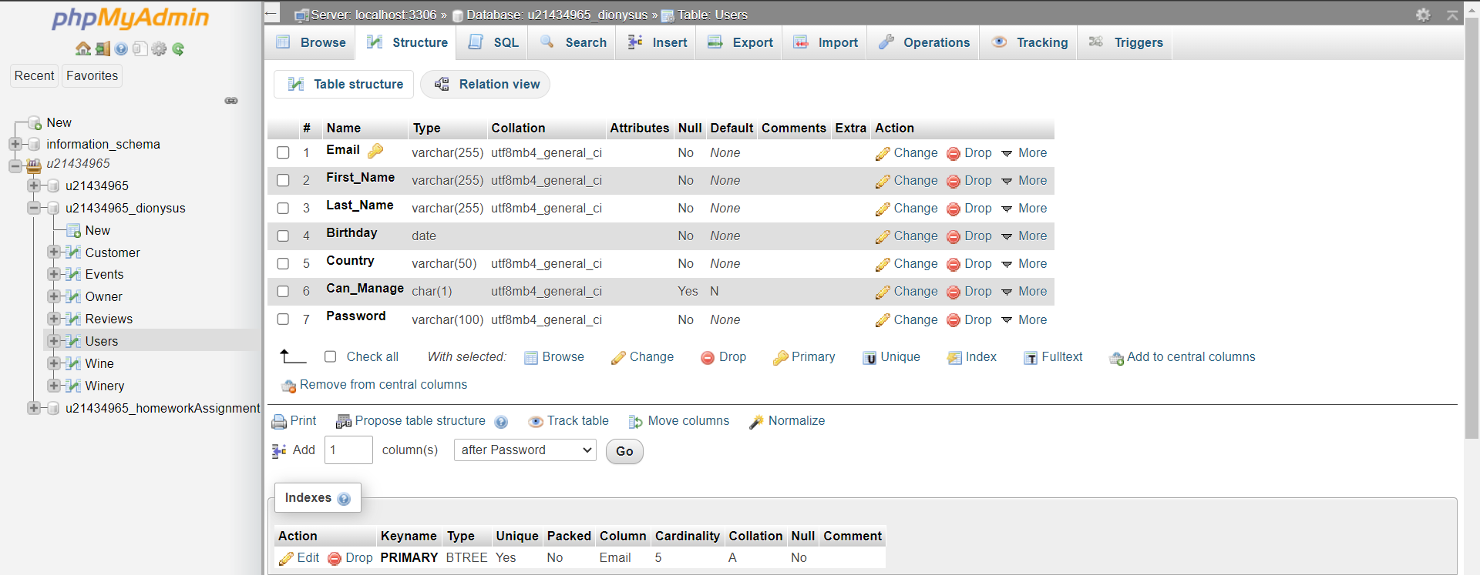
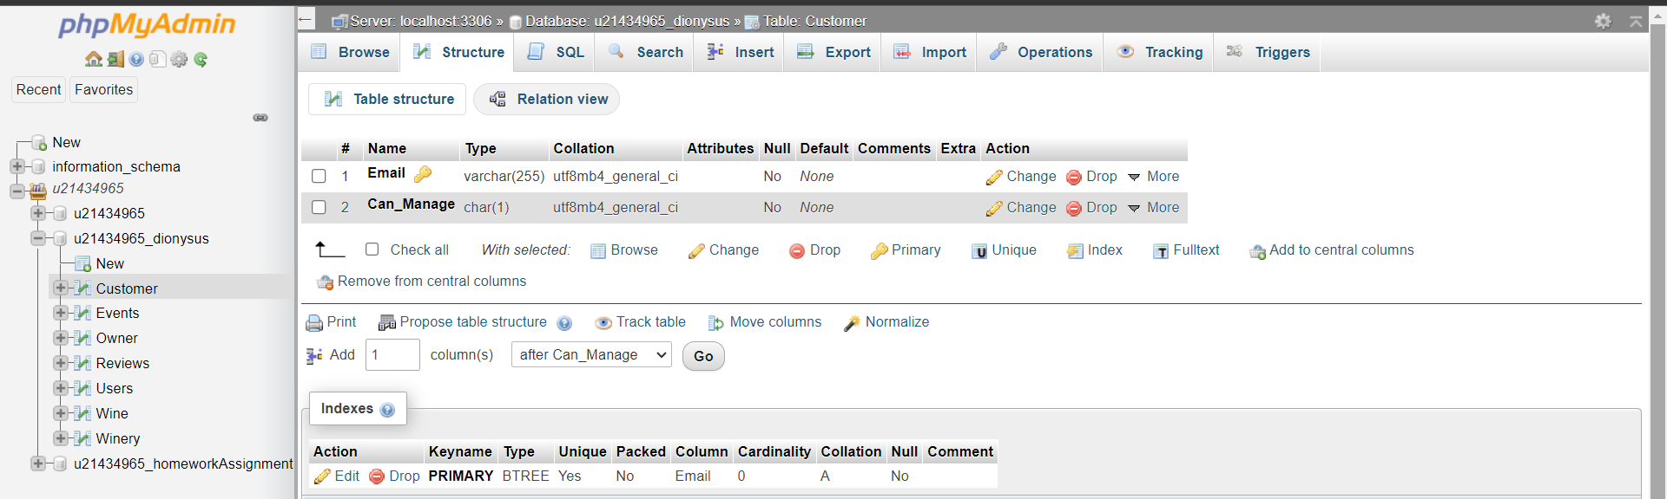

Slide 17
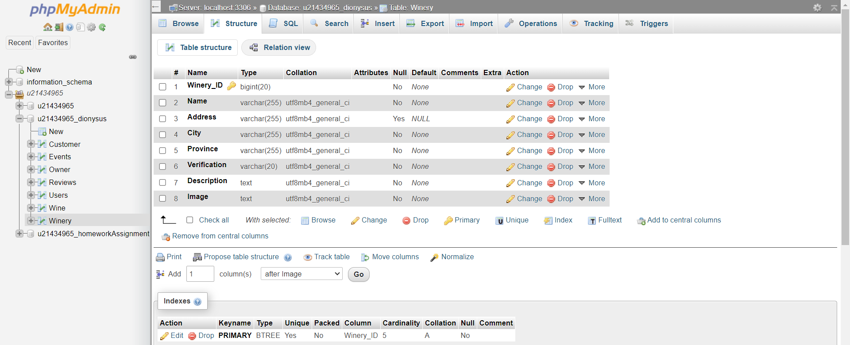
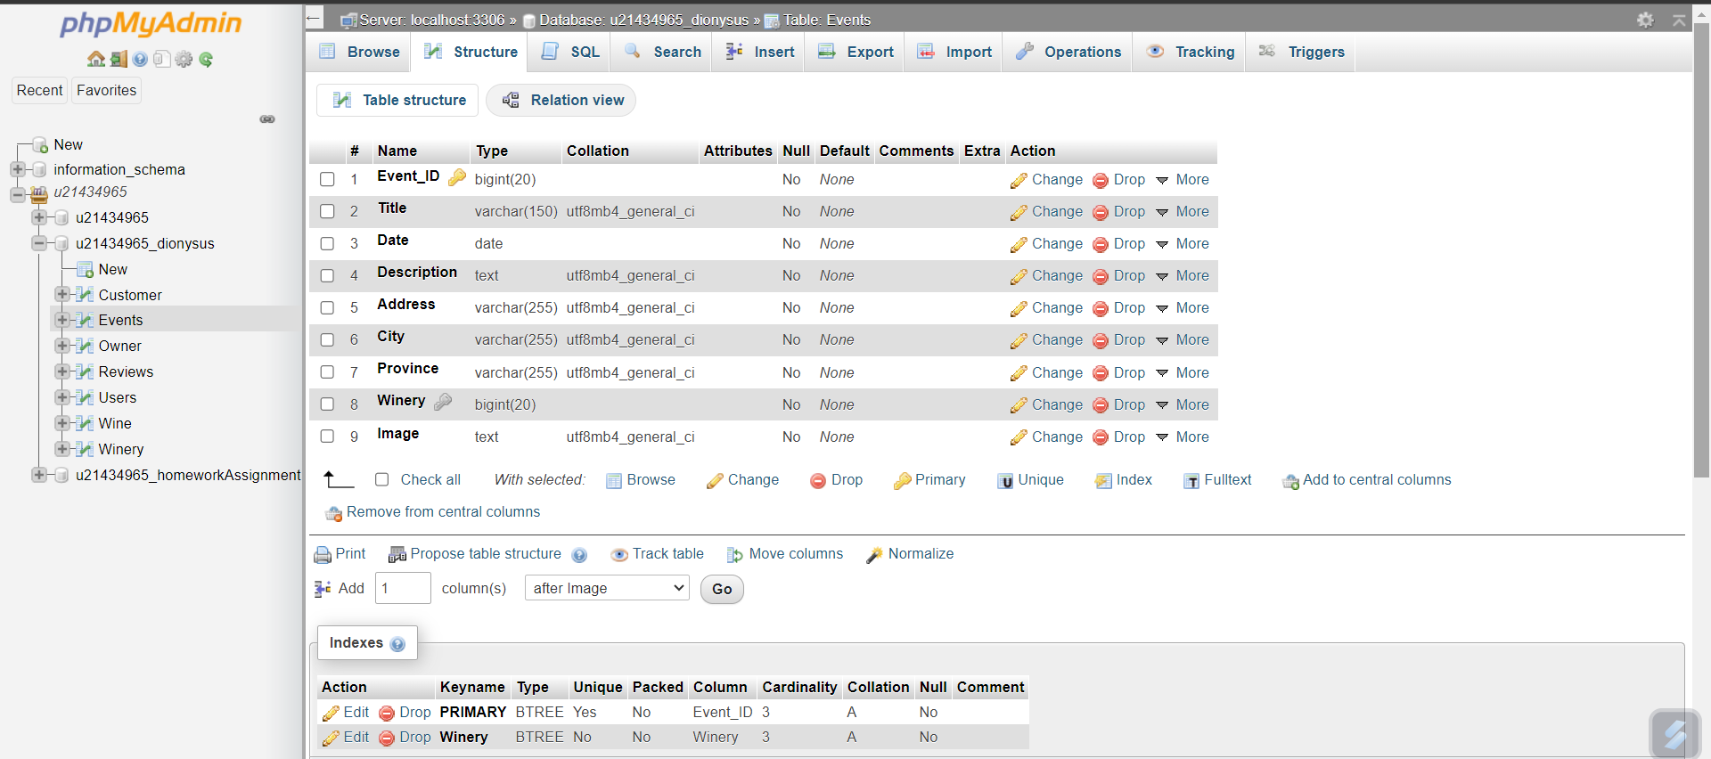
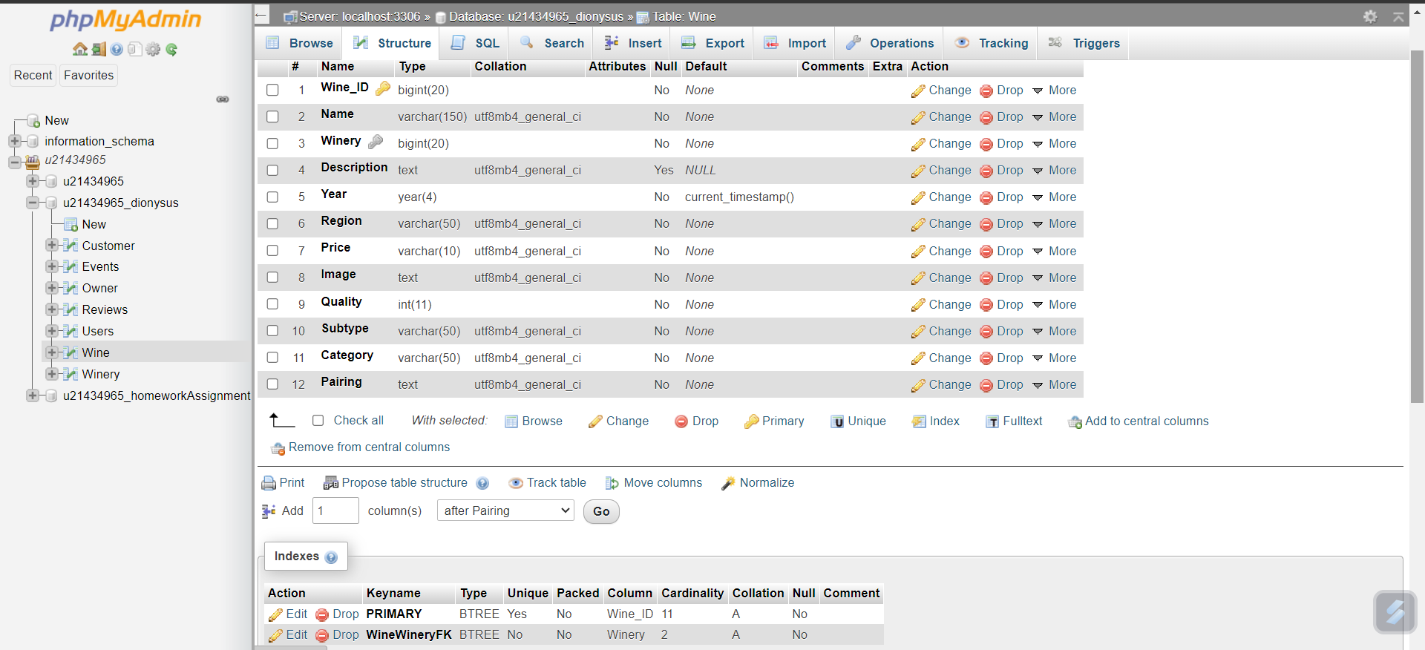
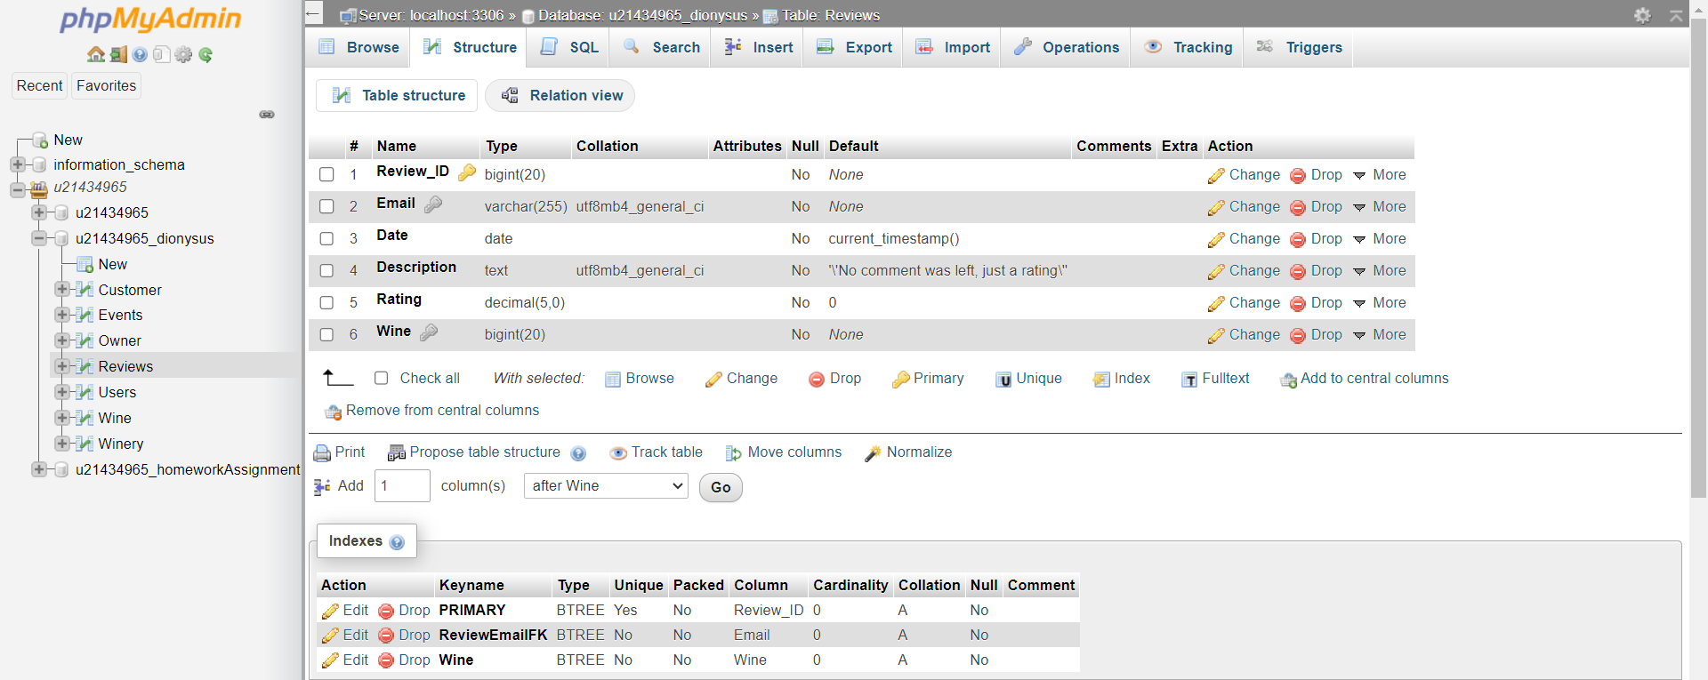

Slide 18
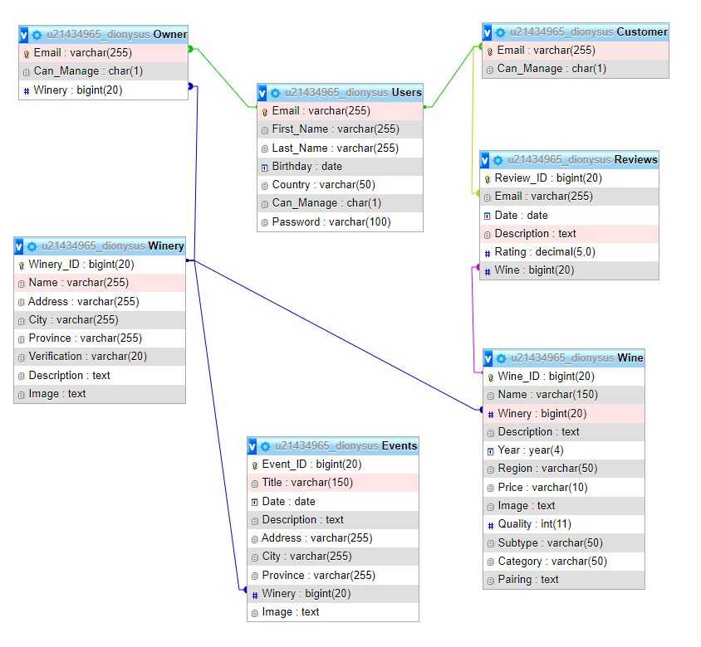
FINAL SCHEMA

Slide 19
TASK 5 : WEB-BASED APPLICATION

Slide 20
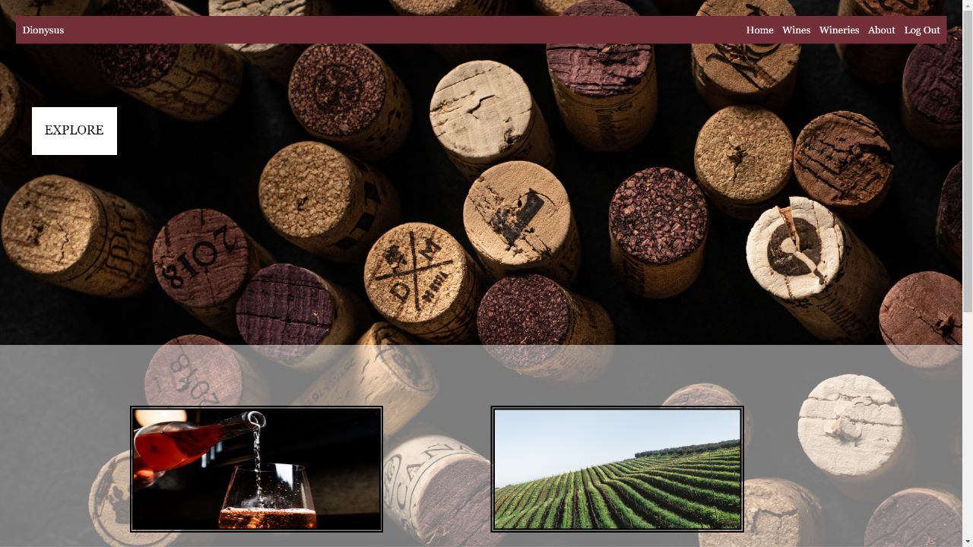
HOMEPAGE

Slide 21
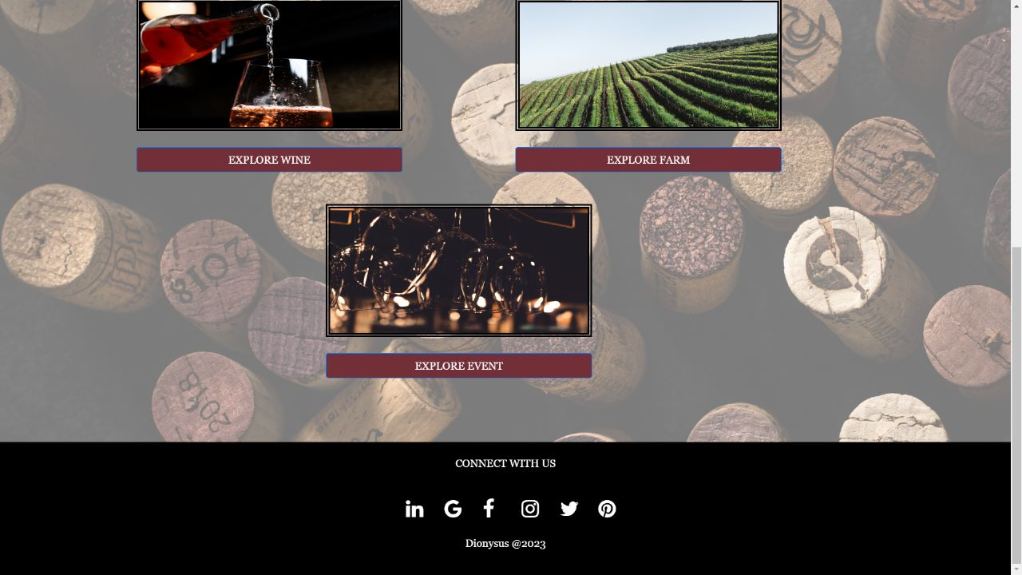
HOMEPAGE

Slide 22
Please make reference to the web-based application for further details
…
WEB-BASED APPLICATION

Slide 23
TASK 6 : DATA

Slide 24
Please view our database on phpmyadmin…
Summary:
55 customers
10 Events
17 owners
28 reviews
75 users
220 wines
18 wineries
And counting….
DATA

Slide 25
Data Wines and Wineries
Wineries and wine:
Castello di Amorosa- Italy
Bodegas Torres-Spain
Château Margaux-France
Penfolds Magill Estate-Australia
Robert Mondavi Winery-California
Bosman Family Vineyards-South Africa
Are all notable wineries as they all have (+)10 wines each.

Slide 26
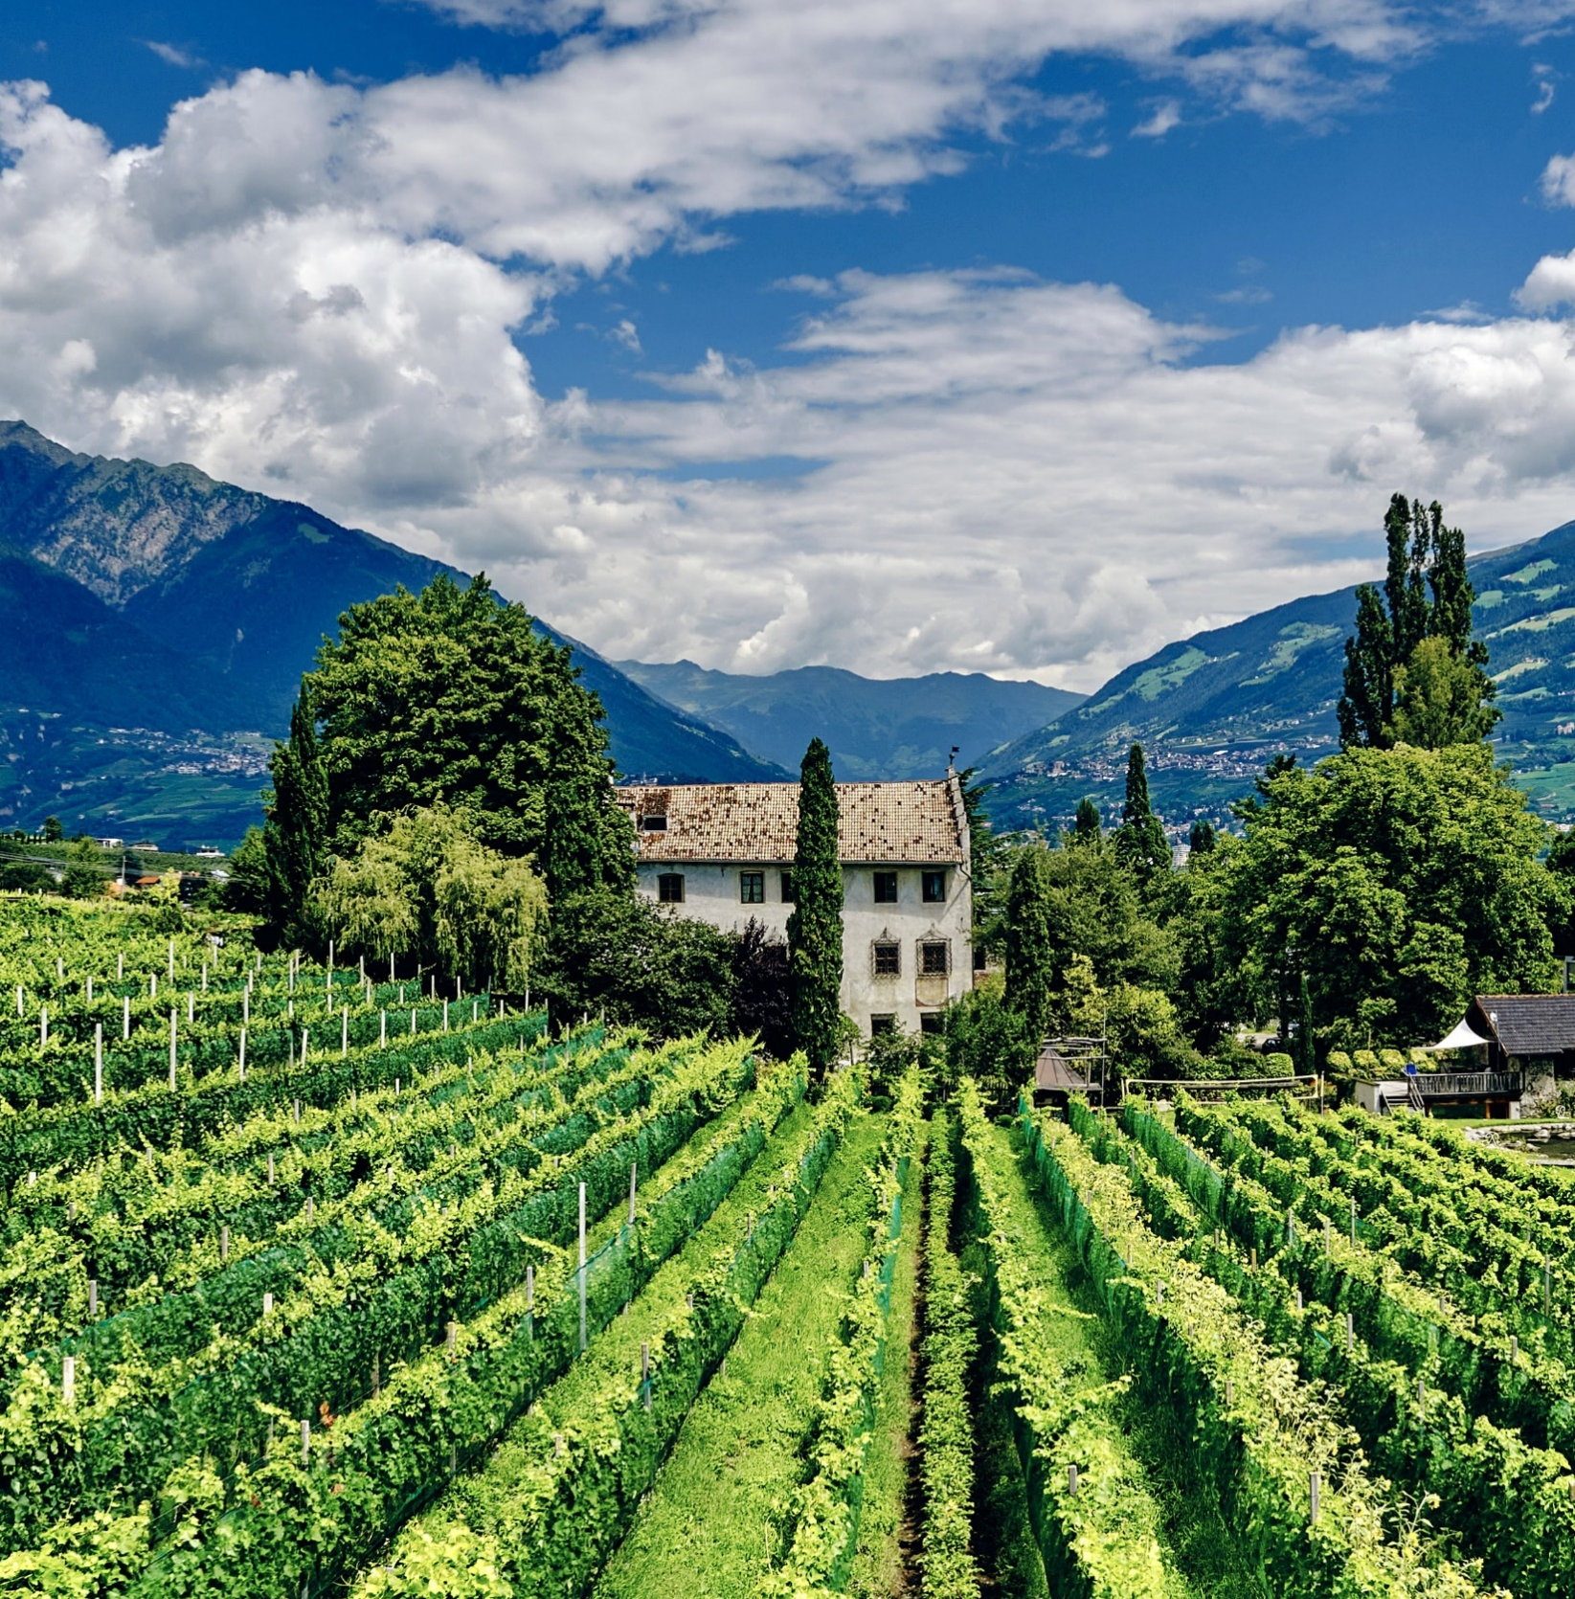
Comments added by members and any questions.

Slide 27
THANK YOU

